Slide 1
Customer Personality Analysis

Slide 2
AGENDA
Objective
Background
Key findings
Recommendations
Appendix:
Data sources
Data methodology
Data assumptions

Slide 3
OBJECTIVE
To analyze customer demographics, spending behavior, and campaign participation to identify key customer segments and their preferences.
To understand the factors influencing total revenue, including web visits, non-web purchases, and customer response to campaigns.
To provide data-driven insights that help businesses optimize marketing strategies, enhance customer engagement, and maximize revenue growth.

Slide 4
BACKGROUND
Businesses collect vast amounts of customer data from various sources, including purchase history, demographics, and online interactions. However, without proper analysis, this data remains underutilized.
Customer Personality Analysis helps segment customers based on their behaviors, preferences, and spending patterns, allowing businesses to tailor marketing strategies and product offerings effectively.
By identifying high-value customer segments, companies can optimize resource allocation, improve customer satisfaction, and increase overall profitability.

Slide 5
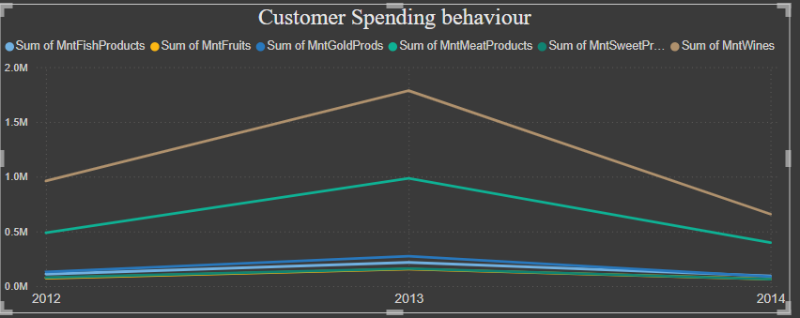
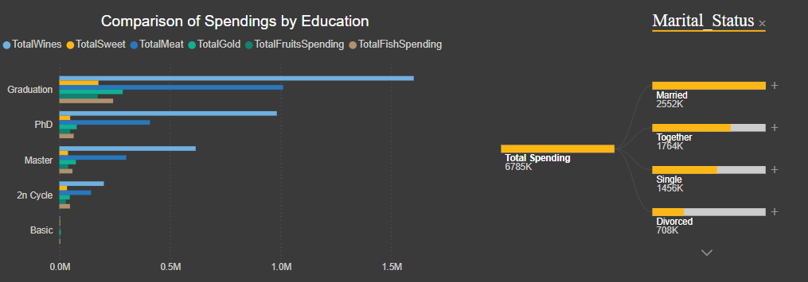
Spending Behaviour & Revenue Trends
Total spending is significantly higher than total revenue, with spending at 6785K and revenue at only 123K, highlighting a major financial gap.
Customer spending behavior shows Mint Wines and Meat Products as the top spending categories, though both experienced a decline in 2014.
Education and marital status impact spending, with graduates spending the most, followed by PhD holders, and married individuals having the highest spending among marital groups.

Slide 6
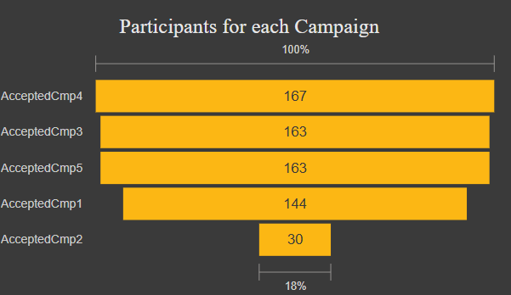
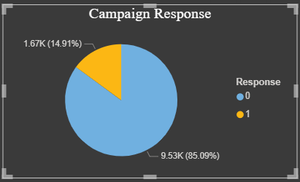
Campaign Performance & Customer Engagement
Campaign response rate is low (1.67%), indicating poor engagement or ineffective targeting.
Campaign 2 had the lowest participation (30 participants), making up only 17.96% of the highest campaign’s participants.
Campaign participation does not necessarily translate into higher spending, suggesting that campaigns need better targeting and alignment with customer spending behavior.

Slide 7
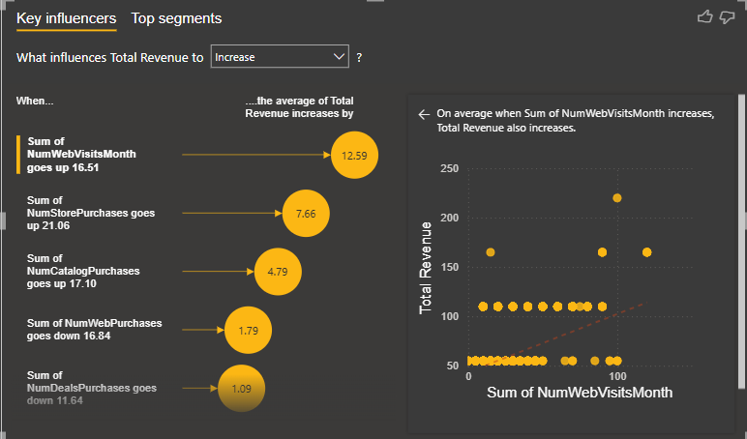
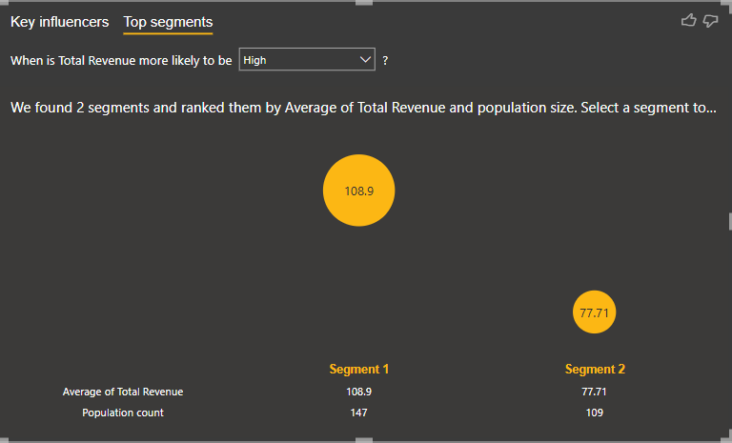
Factors Influencing Revenue
Web traffic and non-web purchases are key drivers of revenue—higher web visits and more non-web purchases lead to increased revenue.
Segment 1 and Segment 2 customers generate the highest total revenue and have the largest customer base, making them the most valuable targets.
While Segment 5 has the highest revenue per customer, its small population suggests that factors other than customer volume influence revenue generation

Slide 8
RECOMMENDATIONS
Enhance Campaign Success by Targeting the Right Audience and Engaging Low-Participation Segments.
Maximize Revenue by Boosting Web Traffic, Non-Web Purchases, and Focusing on High-Value Segments.
Optimize Marketing Strategies to Align with High-Spending Customers and Address Spending-Revenue Imbalance.

Slide 9
APPENDIX - DATA SOURCES
Primary Data Source:
The dataset was obtained from an internship website, containing marketing campaign data
in Excel format.
Dataset Content:
Includes customer demographics, purchasing behavior, campaign participation, web visits, and total spending/revenue.

Slide 10
APPENDIX - DATA METHODOLOGY
Removed duplicate and invalid entries to ensure data accuracy.
Standardized and categorized customer demographic and behavioral data.
Calculated total spending, order frequency, and revenue distribution across customer segments.
Applied statistical methods to identify spending patterns and campaign effectiveness.
Used Power BI and Python (Matplotlib, Seaborn) for data visualization.
Segmented customers based on spending behavior, demographics, and campaign responses.

